Slide 1
Same Offering Date callable and noncallable spread

Slide 2
Step1:取出符合條件之債券
時間:1990/01~2018/06
(102054)
ISSUER_ID, ISSUE_ID, OFFERING_DATE, MATURITY, CALLABLE, OFFERING_YIELD
留下同一個ISSUER_ID在同一天有發行兩張以上債券
(20438)

Slide 3
Step2:留下有資料且有callable & noncallable
只留下OFFERING_YIELD有值且CALLABLE欄位有資料的債券
留下依然符合條件的債券
(1535)
只留下同一ISSUER_ID在同一天有發行兩張以上且至少有一張callable與noncallable
(331)

Slide 4
Step3:計算spread
每張債券計算出發行年限
Treasury Bill Rate(1y,2y,3y,5y,7y,20y,30y)
發行日的年限下，Treasury Bill Rate當作無風險利率，計算spread
Callable的spread小於noncallable，代表此發行者可能利用發長callable 來複製短債

Slide 5
Callable bond spread有低於noncallable的發行者
Issuer | Industry group
GEORGIA PAC CORP | Industrial | Manufacturing
SMITHFIELD FOODS INC
KROGER CO |  | Retail
ROYAL BK CDA | Finance | Banking
BARCLAYS BK PLC
J P MORGAN CHASE & CO
HSBC USA INC
GENERAL MTRS ACCEP CORP |  | Credit/Financing
LEHMAN BROS HLDGS INC |  | Financial Service
GOLDMAN SACHS GROUP INC
PUBLIC SVC ELEC & GAS CO | Utility | Electric
OLD DOMINION ELEC COOP

Slide 6
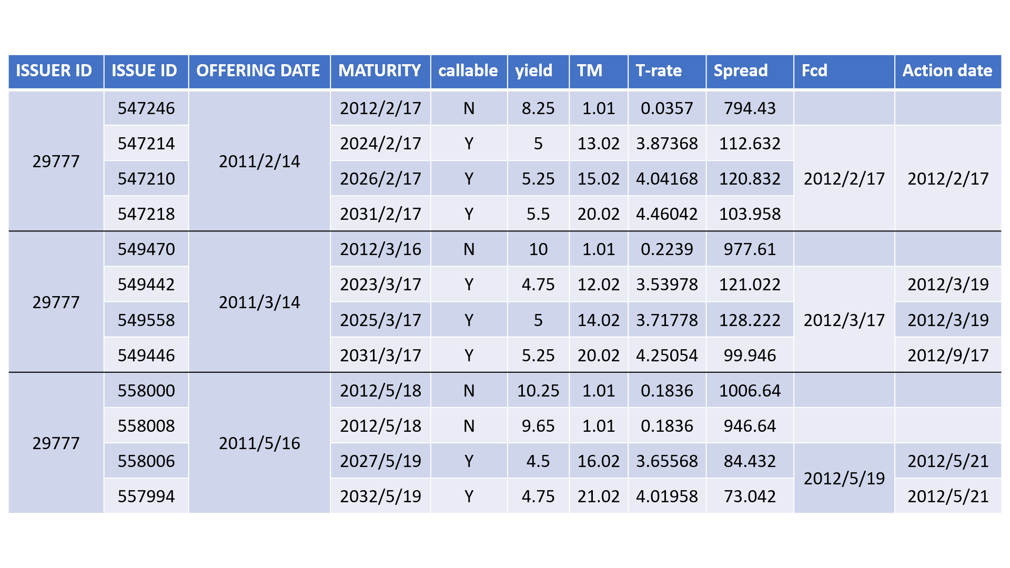

Slide 7
擴大時間範圍(1990~)
多下載offering price 與coupon rate來獲得offering yield
分為industrial, utility, finance

